Slide 1


Slide 2

PRESENTING
DIGITAL
Twin Technology
Presented by:
Wasif Ali
Saad Ali
M. Shaheer
Mohsin Ali
M. Huzaifa

Slide 3

INTRODDUCTION
Digital Twin Technology Virtual replicas of physical objects or systems for real-time feedback, simulations, and operational improvements.
Market Trends: By 2027, 40% of large companies will adopt Digital Twins; market projected to grow from $8B (2022) at 25% CAGR to 2032.
Adoption Insights: 75% of IoT organizations used/planned Digital Twins by 2020; 60% of executives plan integration by 2028.

Slide 4
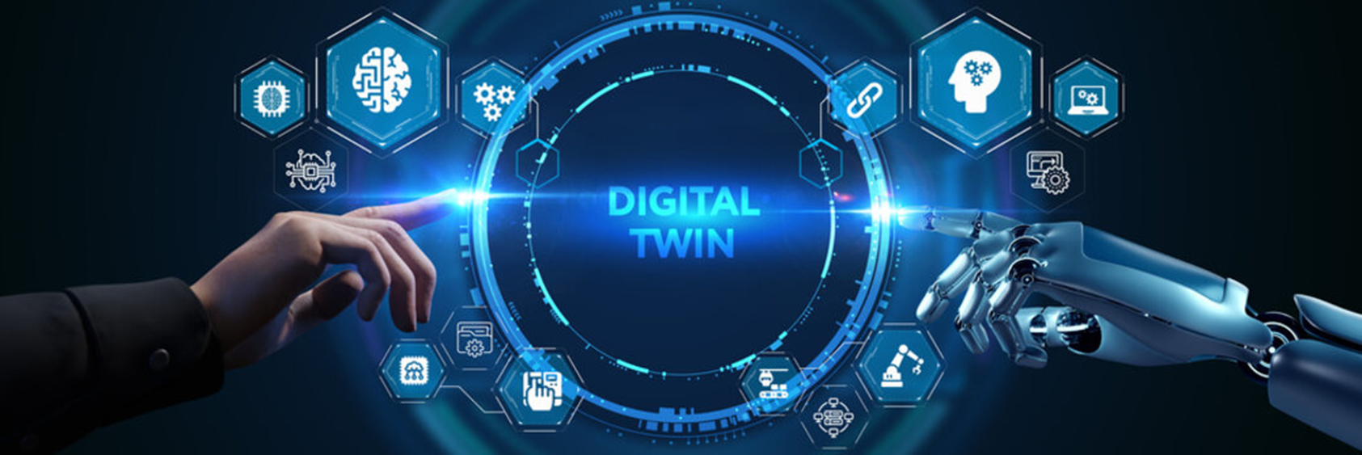
Key Benefits: Faster problem-solving, improved product design, optimized processes, and accelerated value realization.
Applications: Used in manufacturing, healthcare, construction, and transportation to enhance operations and drive innovation.
Challenges: Integration complexity, data security, and resource intensity.

Slide 5
BACKGROUND
1960s: NASA pioneered the concept with "mirrored systems" for spacecraft simulation during the Apollo missions.
1960s
NASA’S Mirrored Systems
2002
Michael Grieves’ Concept
2002: Dr. Michael Grieves first formally introduced the term "Digital Twin" in relation to product lifecycle management.
2010
IoT-Driven Adoption
2014
GE's Industrial Leap
2010s: Widespread industrial adoption began, driven by advancements in IoT, cloud computing, and big data analytics.
2014: General Electric (GE) popularized the concept in the industrial sector by applying digital twins to optimize equipment and asset management.
2020 Onwards
GE Pioneers Digital Twins
Present
Core of Industry 4.0
2020 onwards: Digital twins started expanding to smart cities, healthcare, and personalized medicine, among other industries.
Present: Digital twins are integral to Industry 4.0, enhancing simulations, real-time data analysis, and predictive maintenance.

Slide 6

REFERENCE PAPER
Author : Mohsen Attaran and Bilge Gokhan Celik
Expert Backgrounds:
Attaran is an expert in business and operations from California State University.
Bilge Gokhan Celik focuses on engineering and construction at Roger Williams University.
ABSTRACT:
The use of Digital Twin technology is expanding rapidly and changing how businesses work.
In recent years, Digital Twins have become key tools for solving business challenges.
This technology is expected to grow even more, with new applications and use cases across various industries.

Slide 7

This technology is expected to grow even more, with new applications and use cases across various industries.
Key Focus Areas:
Define what Digital Twins are.
Explain their evolution and development.
Review the technologies that make them work.
Discuss their current trends, challenges, and applications.

Slide 8


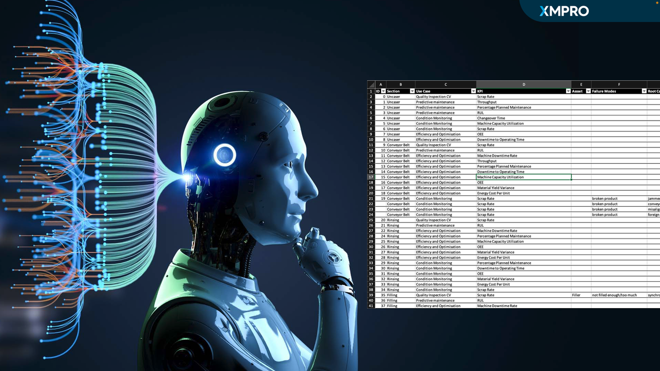
METHODOLOGY
Research Objective:
Understand how Digital Twins improve automation in industries.
Explore applications, challenges, and technologies.
Data Collection:
Gathered information from journals, conference papers, and research reports.
Used platforms like Scopus and Google Scholar for relevant literature.
Focus Areas:
Defined Digital Twins and their technologies.
Reviewed trends, applications, challenges, and future opportunities.

Slide 9



Analysis Steps:
Categorized enabling technologies (e.g., IoT, AI, Cloud).
Examined real-world use cases in sectors like healthcare, manufacturing, and construction.
Evaluation:
Assessed how Digital Twins address real-world problems.
Identified key benefits, barriers, and implementation challenges.
Outcome:
Created a comprehensive overview of Digital Twins to help industries adopt and innovate.

Slide 10

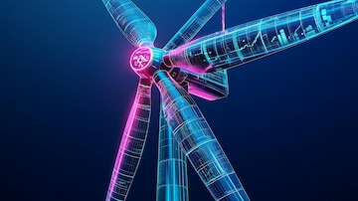
How Digital Twin Works?
Simulation
The Digital Twin creates a virtual version of the system to simulate its behavior under different conditions, like strong winds or icy weather.
Control
Operators can adjust settings remotely through the Digital Twin, such as changing blade angles to improve performance.
Analysis
It analyzes real-time and past data to spot patterns or issues—like detecting a temperature rise that signals potential failure.
Optimization
Engineers can test various configurations in the virtual model to fine-tune performance without touching the real system.

Slide 11
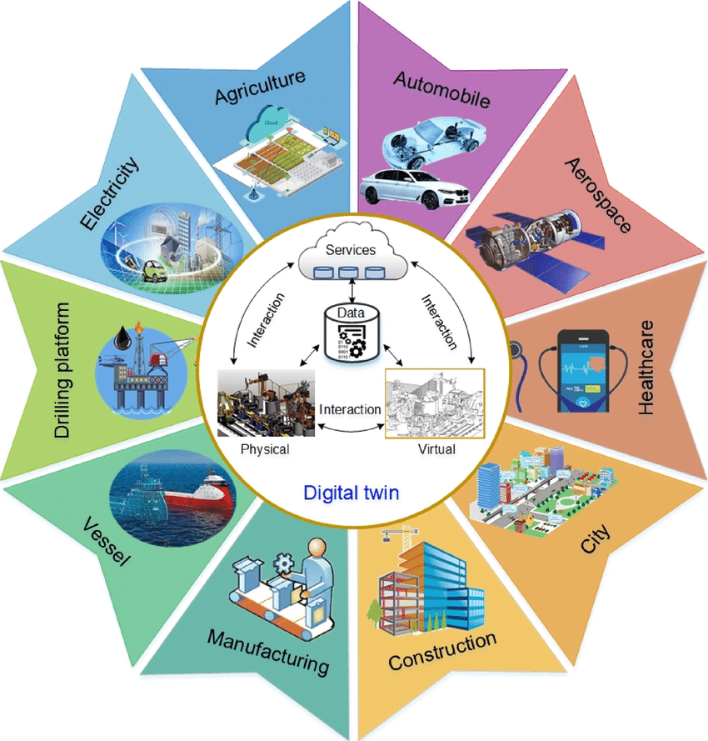
Applications of Digital Twins
Digital twins are like virtual copies of real-world things, such as machines, buildings, or systems. They help us understand and improve how these things work by using live data and computer simulations. Digital Twin can be use:
In Factories: They show how machines are running and warn if something might break.
In Cities: They help manage traffic, design better roads, and save energy in buildings.
In Healthcare: They create digital models of patients to test treatments before trying them.
For Cars: They test new designs and make sure self-driving cars are safe.
In Energy: They track how much power is being used and suggest ways to save more.

Slide 12
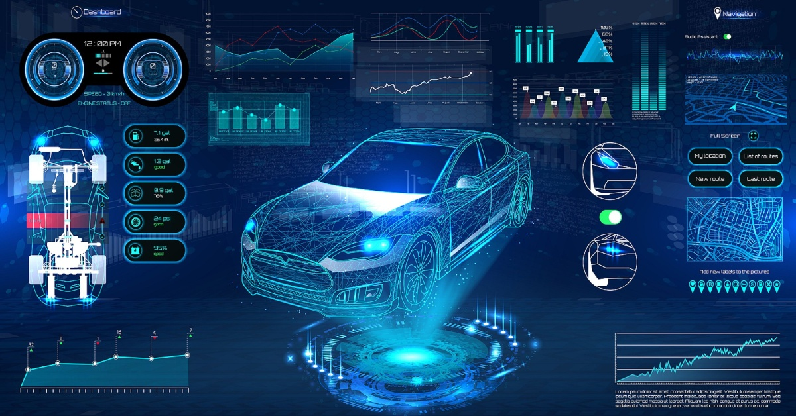

Digital Twin in Cars
Virtual Car, Real Insights: A digital twin is a live, virtual replica of your car.
Predict Problems Early: Identifies brake wear or engine issues before they happen.
Smarter Maintenance: Suggests fixes to save time and money on repairs.
Improved Safety: Simulates crash tests and driving conditions to enhance safety.
Faster Innovation: Tests new designs and features without building physical models.
Eco-Friendly Efficiency: Optimizes performance to reduce fuel use and emissions.

Slide 13
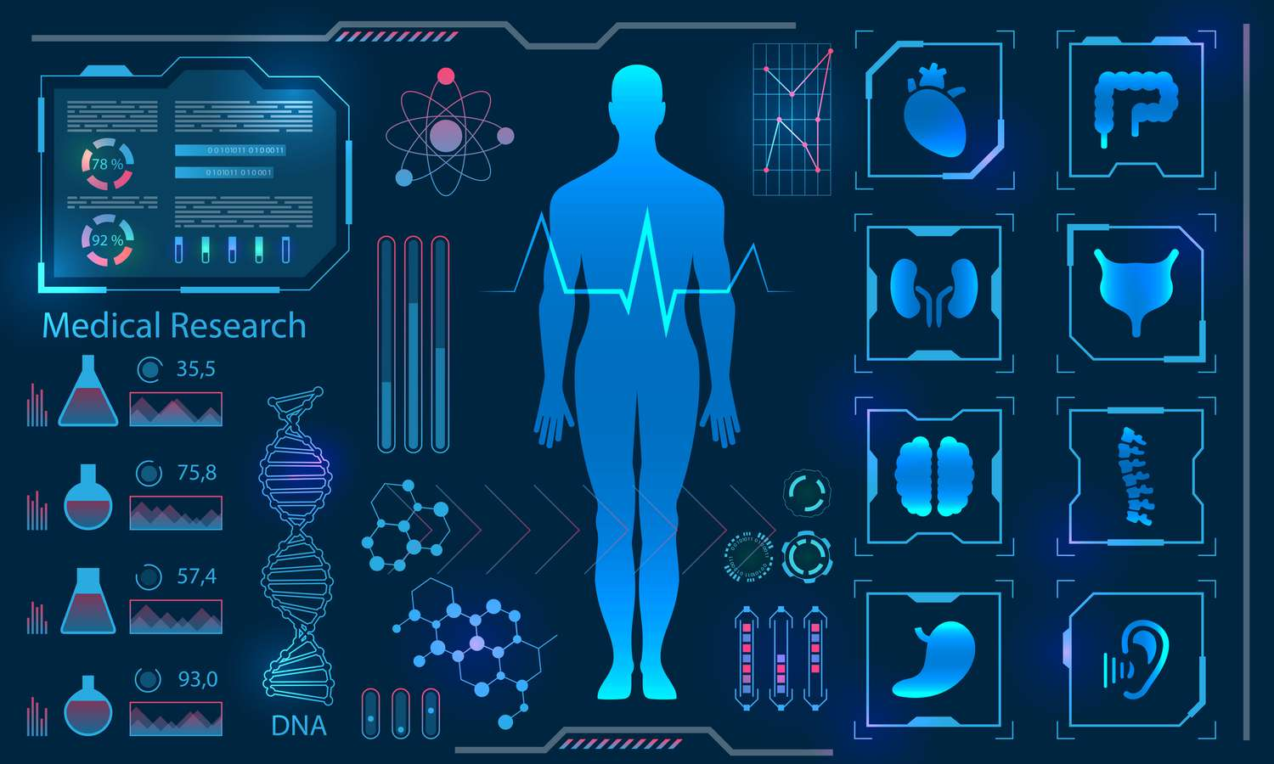
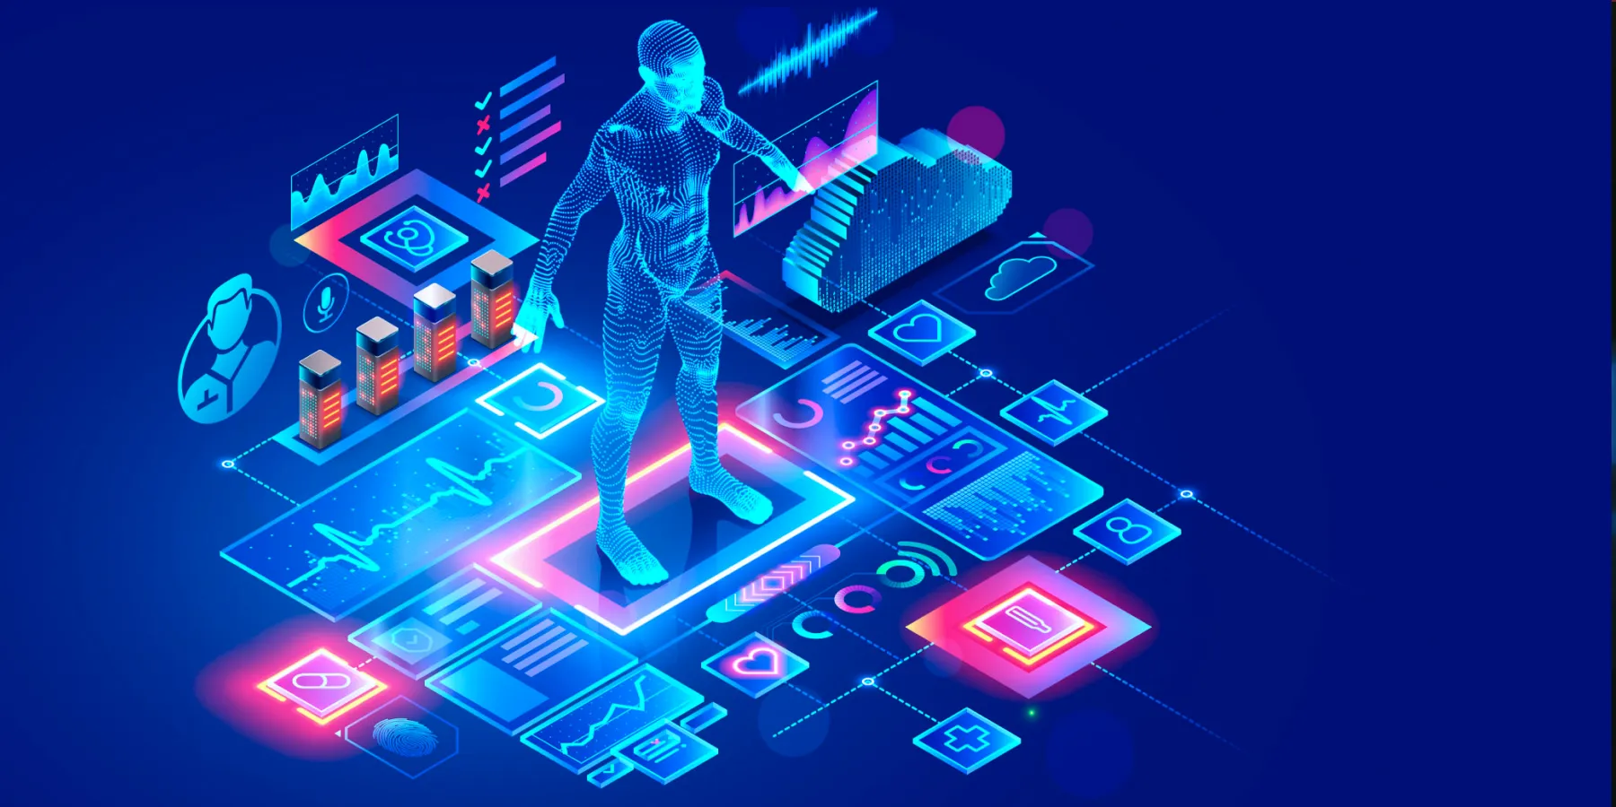
Digital Twin in Health Care
Virtual Patient, Real Care: Creates a digital replica of a patient for personalized treatment.
Predict Health Issues: Anticipates diseases or complications before they occur.
Test Treatments Safely: Simulates drug effects or surgeries without risking the patient.
Improved Diagnosis: Combines real-time data to provide more accurate health insights.
Efficient Hospital Management: Optimizes patient flow and resource allocation.
Faster Medical Innovation: Accelerates the testing of new devices and therapies.

Slide 14


Challenges of Digital Twin Technology
High Cost of Implementation: Setting up a digital twin requires expensive sensors, software, and infrastructure investments.
Data Security Risks: Handling sensitive and real-time data raises concerns about privacy and cybersecurity threats.
Massive Data Requirements: Digital twins rely on continuous data streams, demanding significant storage and computational power.
Standardization Issues: A lack of universal standards for creating and modeling digital twins can slow adoption.

Slide 15



Scalability Limitations: Expanding digital twin systems to large-scale applications may encounter technical and cost barriers.
Connectivity Challenges: Reliable and uninterrupted internet connectivity is critical for real-time updates but not always available.
Maintenance Costs: Upkeep of the digital twin infrastructure, including updates and data quality management, can be resource-intensive.

Slide 16
REFERENCES
Gartner, Gartner survey reveals digital twins are entering mainstream use, 2019, Online:
https://www.gartner.com/en/newsroom/press-releases/2019-02-20-gartner-survey-reveals-digital-twins-are-entering-mai
Gartner, Gartner survey reveals digital twins are entering mainstream use. February, 2019, Online:
https://www.gartner.com/en/newsroom/press-releases/ 2019-02-20-gartner-survey-reveals-digital-twins-are-entering-mai.
Gartner, Top strategic technology trends, 2023, 2022, Online:
https://emtemp.gcom.cloud/ngw/globalassets/en/publications/documents/2023- gartner-top-strategic-technology-trends-ebook.pdf.

Slide 17
CONCLUSION
Rapid Growth: Digital twin technology is expanding quickly across various industries, revolutionizing how businesses operate and innovate.
Enhanced Decision-Making: By providing real-time insights and simulations, digital twins help companies make better, faster decisions.
Industry Adoption: Industries like manufacturing, healthcare, construction, and agriculture are benefiting from digital twins, improving efficiency and reducing costs.
Challenges Remain: Despite its potential, challenges like high costs, data security, and system integration still need to be addressed.
Future Outlook: As technology advances, digital twins will become even more integrated with tools like AI and augmented reality, offering greater insights and capabilities.
Continued Innovation: With more research and development, digital twins are expected to unlock new opportunities and applications, driving future growth across sectors.

Slide 18
Q N A !

